Slide 1
Does Forest Growth Correlate to Happiness?
By Taimoor Arshad
Charlene Gray
Sathya Kulatunga
Nida Hussain

Slide 2
Our Question
We wanted to answer the question: does the environment have a strong correlation to happiness and/or economic growth?
Does forest growth or the presence of any greenery have a tangible and measurable effect on it’s populace?
Is it measureable?
How can we measure this?

Slide 3
“Correlation Does Not Always Mean Causation”
The correlation between forest and the social well being of a populace is complex and multilayered.
For example does the presence of greenery affect the level of oxygen and therefore make people think clearer? If this were true, would it really translate to economic growth? Or would the effects be different for each person and thus be nearly impossible to measure?
We hoped to better answer this question by comparing varied social statistics against local forest density in hopes of discerning a consistent pattern.
However, we ultimately wanted a universal index to compare forest density to in order make a clearer comparison.

Slide 4
Defining Happiness
We needed to make a quantitative measure of happiness and economic growth.
Is it salary based, health based, property based, or something else?
We decided to use various social, health, poverty, and crime statistics as measures of “happiness”.

Slide 5
Defining Forest?
Defining what we considered to be forest was a little bit more straightforward.
However, there were some variations as to what was considered “greenery”.
We decided on using the definitions measured by various state and federal agencies as our definitions.
We also found it was important to distinguish between number/amount of “greenery” and the ratio between “greenery” and local population. In essence, having a forest density measure.
In our study we used square meters of tree canopy cover per person.

Slide 6
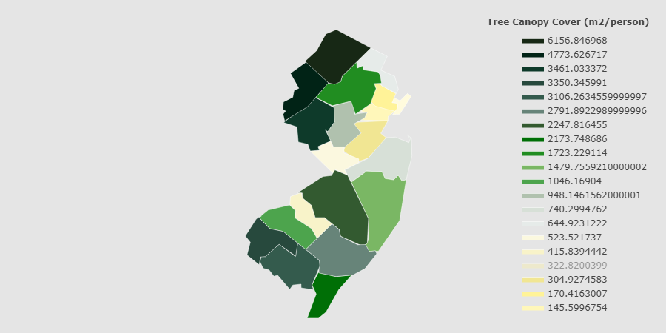
Tree Canopy Cover (m²/person)

Slide 7
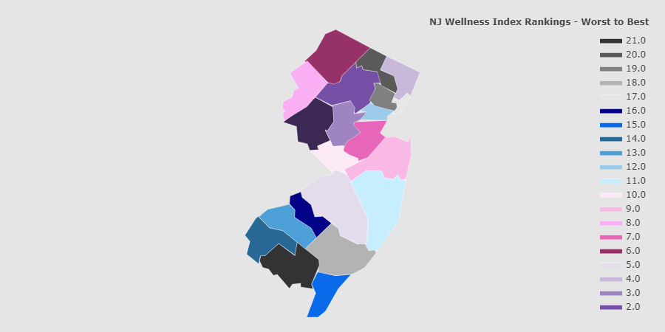
NJ County Wellness Ranking

Slide 8
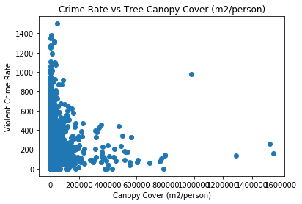
Violent Crime Rate
We can roughly see that there is a negative correlation between Violent Crime Rate and Forest Density

Slide 9
Crime Rates
As with violent crime rates, we see a rough negative correlation.

Slide 10
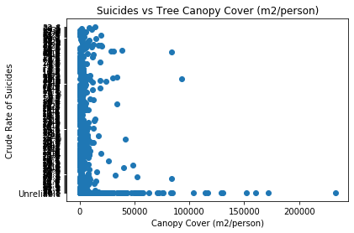
Suicide Rates
Here again, we see a rough negative correlation between Suicide Rates and Forest Density.

Slide 11
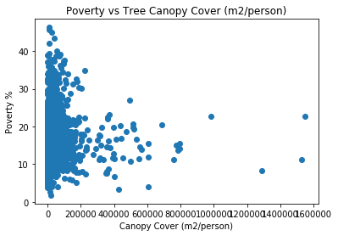
Poverty Rates
Poverty Rates have a negative correlation to Forest Density.

Slide 12
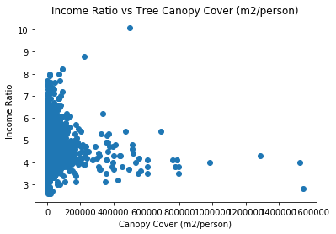
Income Ratio

Slide 13
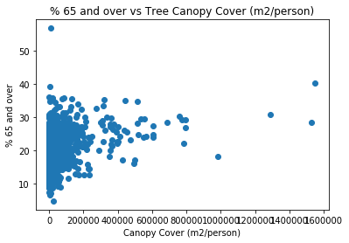
Percentage of Population over 65 years old.

Slide 14
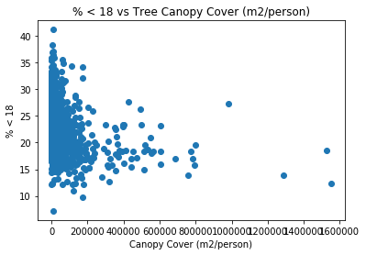
Percentage of Population under 18 years old.

Slide 15
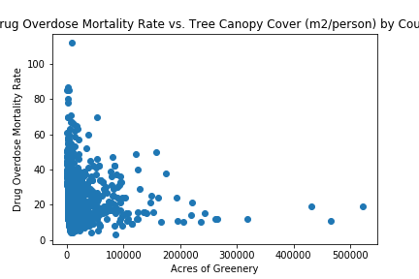
Drug Overdose Mortality Rate

Slide 16
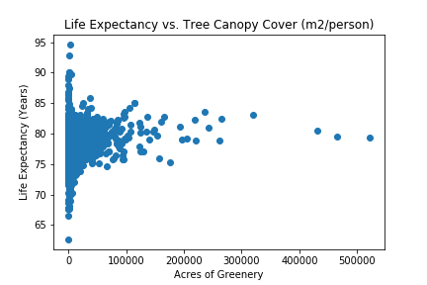
Life Expectancy

Slide 17
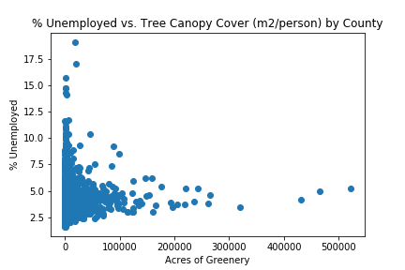
Percent Unemployed

Slide 18
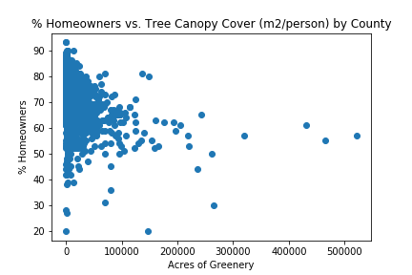
Percentage of Homeowners

Slide 19
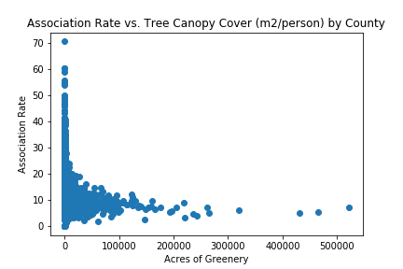
Association Rate (Amount of Community Services/Associations)

